Slide 1
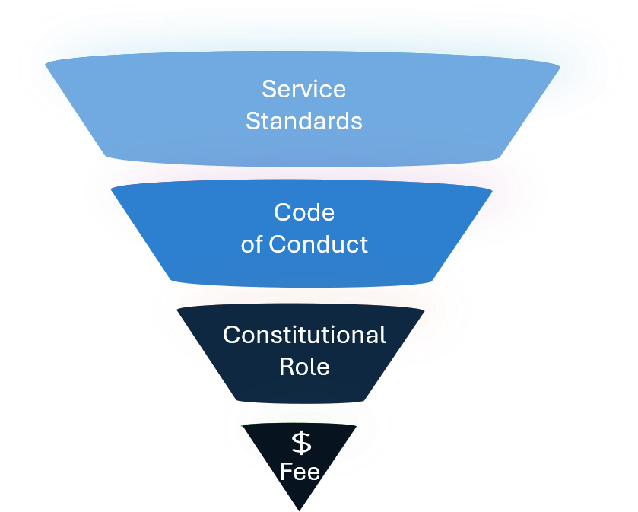
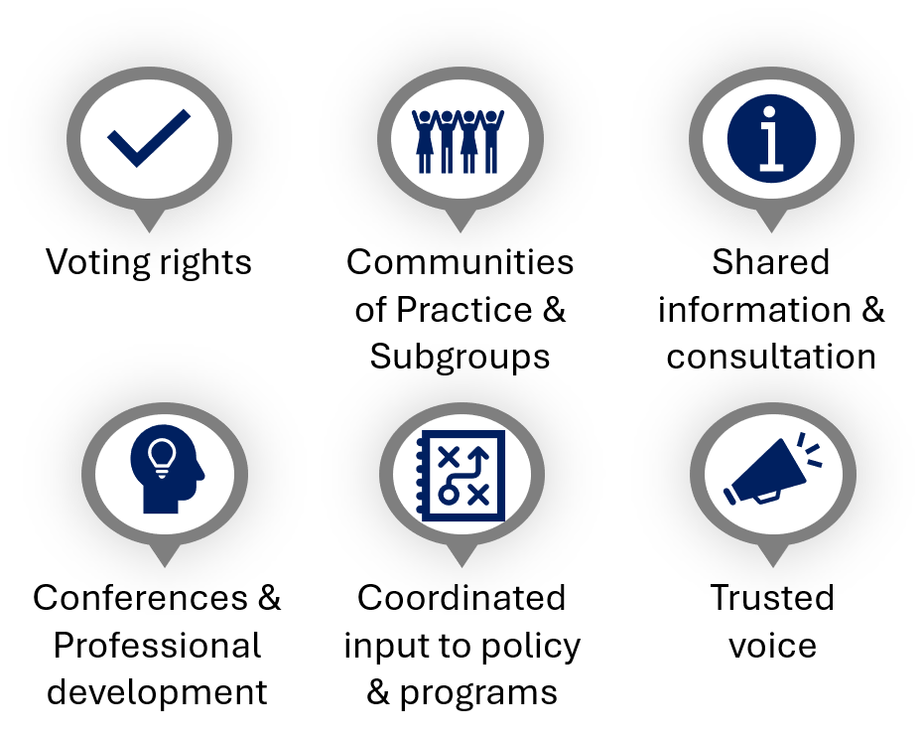
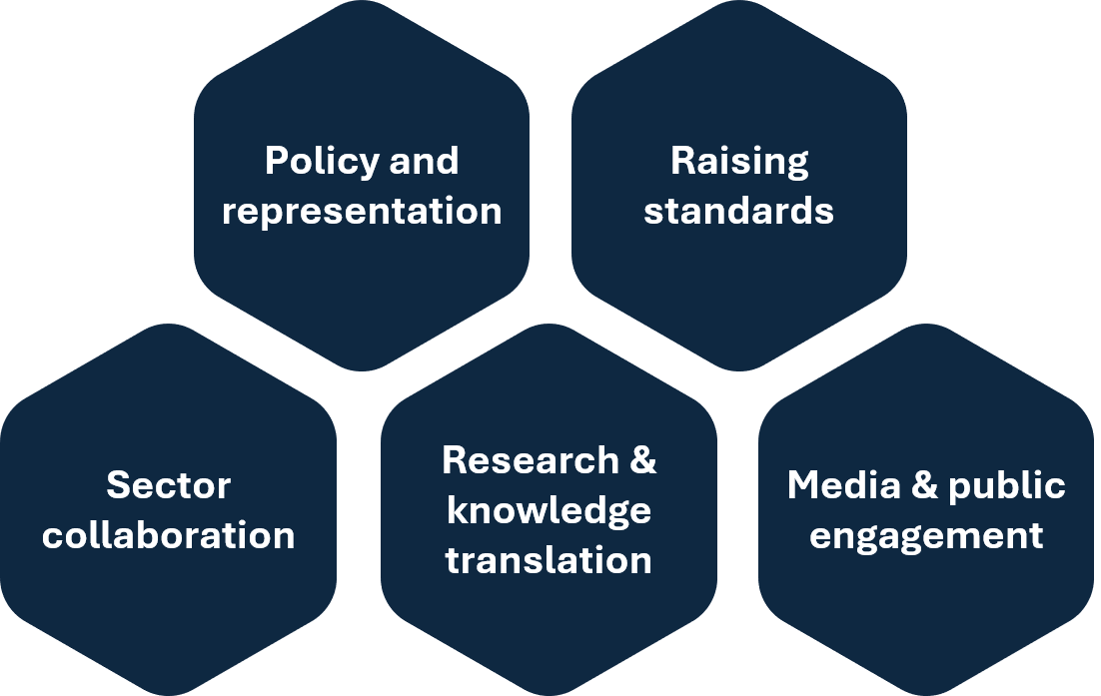
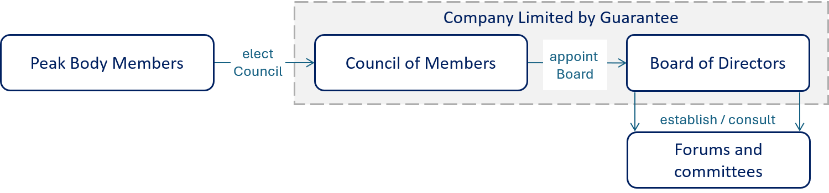
BUSINESS PLAN AT A GLANCE
National Peak Body for Veteran Serving Organisations
Purpose
To improve awareness, access and quality of support available to Australian veterans and families of veterans.
Mission
To connect, strengthen and represent the veteran-serving sector through collaboration, capability development, shared learning and informed policy engagement.
Objectives
Strengthen representation
Provide a strong collective voice by identifying, testing and communicating shared sector priorities and perspectives to government, Defence and other stakeholders.
Improve collaboration
Enable organisations to come together to share information and expertise, develop practical solutions and work collectively on challenges affecting veterans and families.
Build capability
Strengthen capability across the veteran support sector through improved governance, standards, professional development, shared resources and communities of practice.
Improve influence
Drive better outcomes for veterans and families by connecting lived experience, sector expertise, research and evidence to inform policy, programs, reform and public understanding.
What the Peak Body will do
Peak Body membership model
Governance
Last updated: 13 August 2026

Slide 2
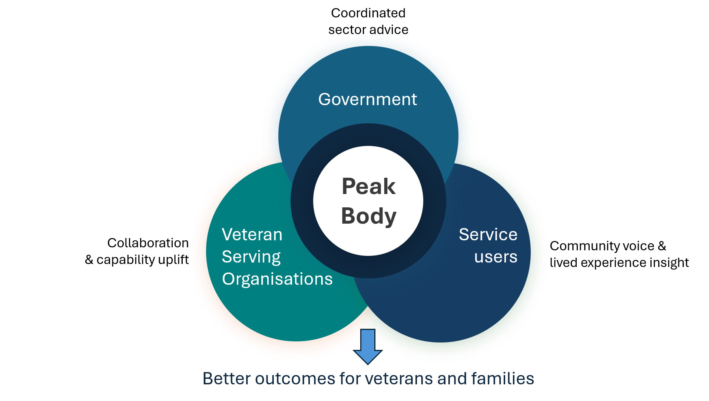
BUSINESS PLAN AT A GLANCE
National Peak Body for Veteran Serving Organisations
The first 12 months should focus on establishment, sector legitimacy and early member value.
Value proposition
Establishment pathway
Independent selection of initial Board
Board establishment & registration
Membership &
Council Members
Full Board and operations
First 12 months priorities
Establish legitimacy | Incorporate entity, appoint Board, approve governance, communicate purpose.
Activate membership | Confirm categories, Charter, Code, fees and onboarding.
Deliver member value | Launch communications, forums and foundational resources.
Represent shared priorities | Set policy engagement protocols and priority-setting mechanisms
Build sustainability | Approve budget, controls and revenue strategy.
Measuring success across five areas
Membership
Influence
Capability
Sustainability
Governance
Measures to be finalised by the Board as part of first-year planning.
Sources of funding
Moving from early-stage funding to mixed revenue model over time.
Key establishment risks to actively manage
Legitimacy and sector buy-in
Participation and representative authority.
Establishment support
Membership fees
Funding uncertainty
Ability to establish and sustain core functions.
Governance failure
Confidence, accountability and legal stewardship.
Last updated: 13 August 2026
Role confusion
Duplication or conflict with existing entities.
Grants & procurement
Sponsorship & philanthropy
Transition gap
Loss of momentum, ownership or readiness after project closure and operational establishment.

