Slide 1
FOOTWEAR SUPPLIERS ONLINE TRAINING
Medical Grade Footwear Program

Slide 2
The aim of this online training is to:
provide you with a better understanding of DVA’s requirements relating to supplying Medical Grade Footwear (MGF).

Slide 3
REHABILITATION APPLIANCES PROGRAM (RAP)
The aim of RAP is to keep veterans in their own homes for as long as possible and to minimise the impact of disabilities, enhance quality of life and maximise independence.
Provides equipment or appliances such as:
Aids to assist daily living activities e.g. mobility aids, home modifications
Treatment aids e.g. continence products, oxygen
Medical Grade Footwear.

Slide 4
WHO IS ELIGIBLE
Gold Card Holders - full range of treatment (footwear supplied where clinically necessary)
White Card Holders - full range of treatment for accepted disabilities (footwear supplied where clinically necessary for accepted disability)
** White Card Holders need prior approval before podiatry treatment and footwear supply. To check a White Card Holder’s eligibility for services contact DVA on
1300 550 457.

Slide 5
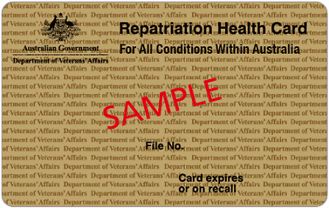
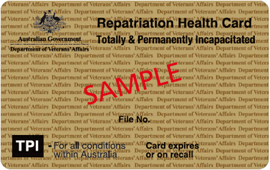
THE CARDS
GOLD card holders assessed on basis of clinical need
The TPI Gold Card looks the same but references Totally & Permanently Incapacitated
http://www.dva.gov.au/providers/dva-health-cards
Notes:
http://factsheets.dva.gov.au/factsheets/
Overview of cards Factsheet IS160
GOLD CARD
Factsheet HSV01

Slide 6
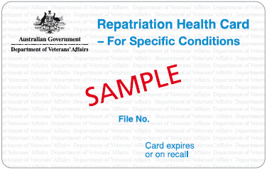
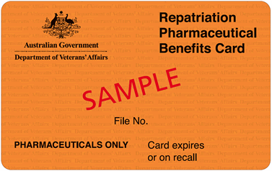
THE CARDS cont.
WHITE card holders assessed on basis of clinical need related to a specific Accepted Disability (AD)
No eligibility for RAP items
Pharmaceuticals ONLY
http://www.dva.gov.au/providers/dva-health-cards
Notes:
FACT SHEETS
http://factsheets.dva.gov.au/factsheets/
WHITE CARD
Factsheet HSV61
ORANGE CARD
Factsheet HSV69

Slide 7
AN OUTLINE OF
THE
MEDICAL GRADE FOOTWEAR
PROGRAM

Slide 8
MEDICAL GRADE FOOTWEAR (MGF)
Program Aim
To provide MGF and related services that are of a high standard and clinically appropriate.
Purpose of MGF Supply
MGF may be prescribed when readily available suitable everyday footwear cannot be used or modified for this purpose.

Slide 9
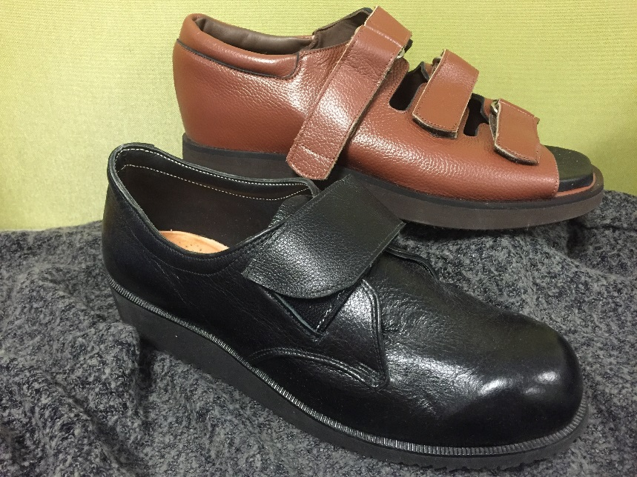
MEDICAL GRADE FOOTWEAR
Definition:
Footwear clinically prescribed to accommodate
and/or correct abnormal foot and/or ankle
structure or significant deformity.
DVA provides two types of medical grade footwear:
Ready made extra depth/width footwear
Custom made footwear

Slide 10
Medical Grade Footwear READY MADE
Ready made MGF is footwear that has specific features of extra depth and/or extra width added to the shoe last so the completed shoe can accommodate foot abnormalities.
This footwear is listed on the MGF Register:
http://www.dva.gov.au/providers/provider-programs/rehabilitation-appliances-program-rap#medical-grade
Acceptance on the MGF Register is determined by DVA in accordance with the departmental document
“Technical Specifications of Medical Grade Footwear”.

Slide 11
Medical Grade Footwear CUSTOM MADE
Custom MGF is footwear manufactured to individual and DVA technical specifications:
Made from individual lasts/casts & patterns to replicate the feet.
Specifically designed to accommodate abnormal foot/ankle structure or gross deformities of the feet.
Provided where ready made MGF cannot accommodate these conditions and has been approved by DVA.

Slide 12
MEDICAL GRADE FOOTWEAR (MGF) - Supply
Suitably qualified and experienced MGF suppliers are required to enter into an agreement with DVA to provide these services and products to DVA clients.
A supplier must agree with DVA’s Medical Grade Footwear Terms and Conditions.
The “Notes for Medical Grade Footwear Suppliers” outlines the process and responsibilities of supply and departmental requirements. http://www.dva.gov.au/providers/provider-programs/rehabilitation-appliances-program-rap#medical-grade
MGF services are activated by the receipt of a MGF prescription form (D0688) from an assessing health provider.

Slide 13
MEDICAL GRADE FOOTWEAR (MGF) - Assessors
Approved assessing health providers for MGF are podiatrists or medical specialists i.e. Vascular Surgeon, Orthopaedic Surgeon, Rehabilitation Specialist or Rheumatologist.
The majority of prescriptions for MGF will originate from podiatrists.
MGF prescriptions are completed using the D0688 form. http://www.dva.gov.au/sites/default/files/dvaforms/D0688.pdf
DVA views assessing health providers as MGF Case Managers and rely on their professional clinical expertise to ensure the MGF Program is effective in its purpose and operation.

Slide 14
MGF can be prescribed when:
Appropriate treatment and appliance therapy
have been tried and failed.
Where appropriate, shoe modifications to the
entitled person’s own footwear have been tried
and failed.
There is significant clinical need and the
deformity or condition cannot be managed
without the use of ready made or custom MGF.

Slide 15
FORM D0688 FOR MGF PRESCRIPTION & SUPPLY
All MGF is supplied on the primary criteria that there exists sufficient clinical justification.
The D0688 form must be used when prescribing MGF.
Section A is completed by the assessing health provider according to their clinical assessment and review of the entitled person’s footwear.
Section B is completed by the MGF supplier after measuring and conducting a trial fit where appropriate.
Section C is completed by the assessing health provider after the MGF is supplied to verify quality, fit and suitability of the footwear.
Cont.

Slide 16
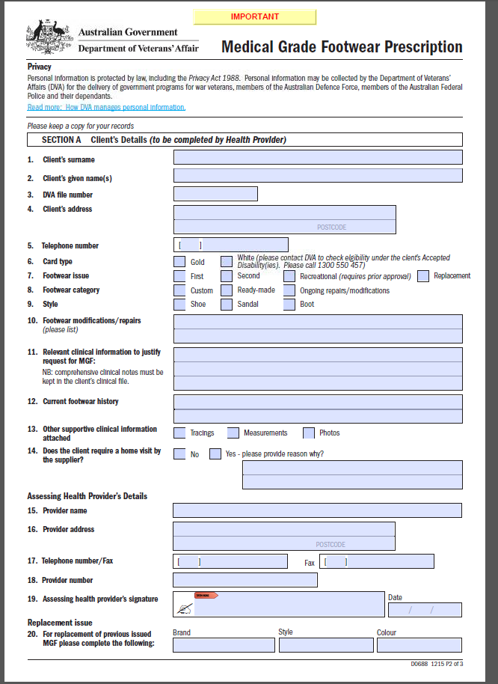

Slide 17
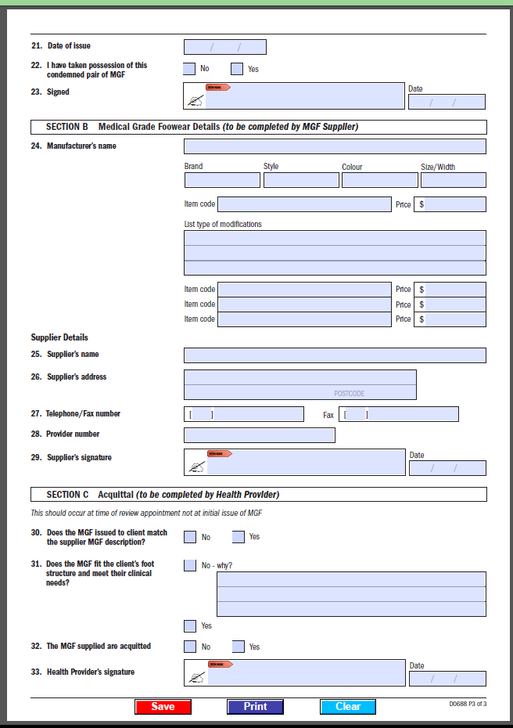

Slide 18
D0688 FORM FOR MGF PRESCRIPTION & SUPPLY
When a supplier assesses the entitled person as requiring MGF services that differ to what is prescribed on the D0688 form, they should firstly contact the assessing health provider to discuss.
The supplier and the assessing health provider are to foster open communication and professional collaboration to ensure the best outcome for the entitled person within the framework of DVA legislation and MGF guidelines.

Slide 19
PRIOR APPROVAL PROCESS
Prior approval is required for MGF requests relating to:
Custom footwear
White card holders
Recreational footwear
Repairs and modifications not listed on the MGF Schedule of Fees

Slide 20
PRIOR APPROVAL PROCESS
The MGF supplier sends the completed D0688 into RAP for processing.
When DVA makes a determination notification will be sent to the
assessing health provider
supplier
entitled person.

Slide 21
TECHNICAL CRITERIA
The document “Technical Specifications of Medical Grade Footwear” is available as Attachment A in the The Notes for Medical Grade Footwear Suppliers.
Components used in the manufacture, supply, repair or modification of MGF for entitled persons shall conform to the technical specifications as outlined in this document.
Overall, MGF should have:
Good quality leather uppers
Light coloured linings
Components free of wrinkles or creases
Designs that allow easy donning and doffing
Materials that enable an average lifespan expectancy of 2 years.
MGF suppliers are to ensure MGF items supplied meet DVA’s quality standards.

Slide 22
REFERRAL MGF FLOWCHART
Entitled persons can be referred by the LMO to either Medical Specialists or Podiatrists for MGF assessment.
Entitled person
LMO
Provides referral
Podiatrist
Assess and provides prescription for MGF
Specialist
Assess and provides prescription for MGF
Supplier
Measures, fits and supplies ready made MGF as appropriate; or
Provides quote for supply of custom MGF
DVA – RAP section
Custom made and recreational MGF, white card holders and modifications not listed on the MGF Schedule require prior approval

Slide 23
HOW MANY? - SHOES
2 pairs day/dress shoes at any one time. *
1 pair recreational shoes - where MGF needs to be modified to comply with a sporting club regulation. Must provide club letter confirming financial membership & playing status. REQUIRES PRIOR APPROVAL
1 pair work shoes if required by an employer, in addition to day shoes - may need confirmation from employer e.g. safety shoes. REQUIRES PRIOR APPROVAL
1 extra pair of day shoes for rural and remote residents (defined as >100km from a suitable assessing health providers).
* The request for more than ONE pair of day shoes is determined by the assessing health provider in consultation with the entitled person, taking into consideration their activity levels and lifestyle.

Slide 24
REPAIRS AND MODIFICATIONS
DVA pays for repairs to current DVA footwear - script given to entitled person.
Routine repairs may be done by the original supplier without need for prescription.
Contracted suppliers are required to manage any warranty needs e.g. repairs (generally 12mths).
An exception: unless extreme access issues exist in visiting or sending shoes to the contracted supplier. If this is the case, assessing health provider needs to keep adequate notes.
After the warranty period repairs may also be done by non-contracted suppliers where access is difficult for the entitled person. The supplier will need to send the invoice to DVA with a copy of the script.
Repairs to stock footwear is limited to repair/replacement of modifications originally funded by DVA.

Slide 25
HOW MANY? MODIFICATIONS TO NON DVA FOOTWEAR
Where an entitled person does not meet the criteria for MGF but clinically requires modifications to their own suitable self purchased stock footwear, the assessing health provider may refer them to a contracted supplier.
Clinically required modifications to non-DVA supplied footwear may include heel collars, sole raises, stretching etc.
Limit of 3 self purchased footwear can be modified in any one year.
Details of the modifications must be documented on the MGF prescription form.
Local repairers are able to modify footwear after the warranty period has passed - send invoice to DVA with a copy of the script.

Slide 26
FOOTWEAR EXCLUSIONS
These shoe styles by their nature cannot meet MGF specifications and are precluded from being supplied:
stock or off-the-shelf shoes
slip-on shoes/boots/court shoes
runners/joggers – sports styled, dual density soling units
‘reef style’ or ‘orthopaedic’ sandals/shoes with moulded footbeds

Slide 27
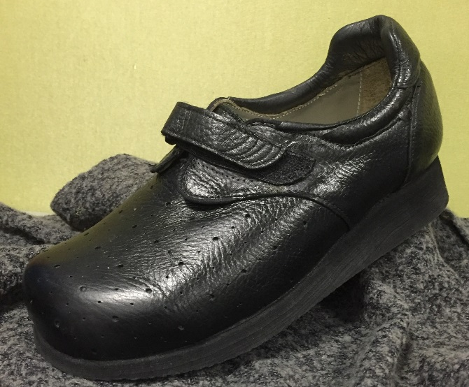
WARRANTIES
New ready made and custom MGF - 12 months (workmanship, materials, fitting)
Repairs/modifications - 3 months
As a quality assurance measure, DVA may request the return of shoes that have failed to last an acceptable period of time.

Slide 28
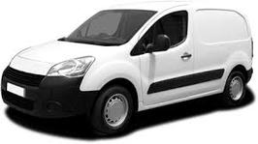
HOME VISITS BY SUPPLIERS
Home visits must be requested on the prescription form by the assessing health provider outlining the clinical reasons why the entitled person cannot be transported to supplier.
Considered only where it is clear the entitled person is medically confined to home. A general rule of thumb is:
1 (one) home visit for ready made MGF; and
2 (two) visits for custom MGF when requested by the assessing health provider.
Can be claimed directly by the supplier, according to the
“DVA Schedule of Fees Medical Grade Footwear Suppliers”

Slide 29
WEBSITE LINKS
MGF Register and the Notes for Medical Grade Footwear Suppliers
Go to:
http://www.dva.gov.au/providers/provider-programs/rehabilitation-appliances-program-rap#medical-grade
MGF Fee Schedule
Go to:
http://www.dva.gov.au/providers/fee-schedules/dental-and-allied-health-fee-schedules
MGF Prescription form (D0688)
Go to:
http://www.dva.gov.au/sites/default/files/dvaforms/D0688.pdf

Slide 30
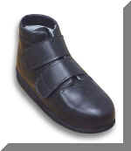
DECIDING READY MADE OR CUSTOM
There are many factors which affect this decision.
Foremost consideration should be given to any fluctuating clinical conditions. They will need to be stable before prescribing MGF e.g. oedema; recent foot surgery.
It is essential that there is an up-to-date medical history.
The following shoe features should
also be considered:
Counter
Lug Length
Modifications

Slide 31
CUSTOM MGF
Custom MGF is generally required when:
Toe box needs to be 30mm or higher
Forefoot width is in excess of 3 fittings wider than
hindfoot
Equinus foot shape
Rocker bottom foot
Severely adducted or abducted forefoot
Excessive oedema
Severe Rheumatoid deformities
Other deformities which cannot be accommodated in
depth/width footwear e.g. marked asymmetry between feet

Slide 32
FILLING IN THE PRESCRIPTION FORM D0688
The MGF supplier is responsible for completing Section B of the D0688.
Upon receipt of the prescription form with Section A completed by the assessing health provider, the supplier should measure, fit and trial appropriate MGF.
The supply of footwear must be in accordance with the Notes for Medical Grade Footwear Suppliers.
Footwear must not differ from that requested on the prescription form.
Ready made MGF must be selected from the MGF Register.
A copy of the D0688 with Section B completed should be sent to the assessing health provider with the MGF for final supply.

Slide 33
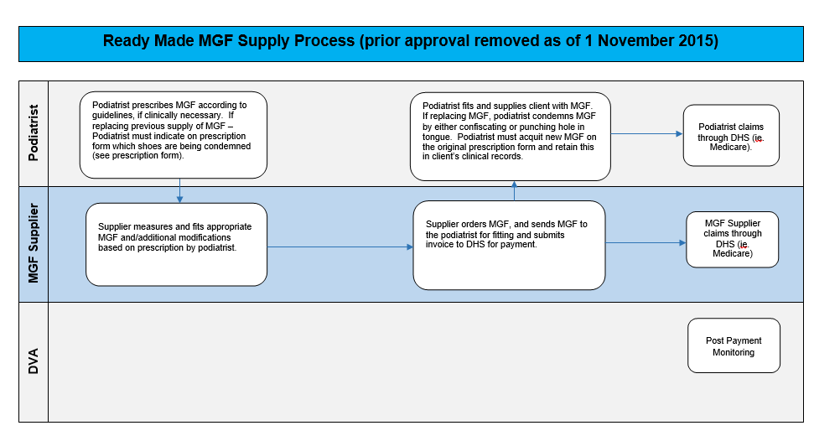
Ready Made MGF Supply Workflow

Slide 34
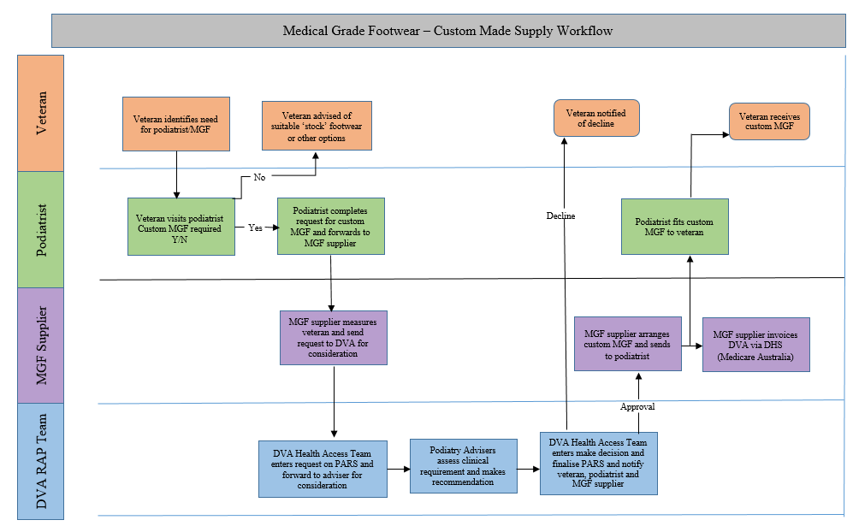
Custom Made MGF Supply Workflow
Insert flow chart from notes for MGF suppliers

Slide 35
ACQUITTALS
The assessing health provider prescribing the MGF is the case manager and has the responsibility to hold accountable the supply of MGF.
Acquittal - is the formal “sign off” that the footwear is as prescribed by the case manager and suitable for the purpose for which it has been requested.
Acquittal maintains the warranty.
Acquittals are to be recorded by the assessing health provider on the D0688 or in entitled person’s clinical notes and comments made as necessary.

Slide 36
TRANSPORT TO MGF
SUPPLIERS
Entitled persons can claim reimbursement for travel costs to attend for MGF services to the closest practical supplier - taxis or mileage.
Booked Car Scheme (BCS) is available to all entitled persons aged 80 years of age or over. Health providers can arrange transport under the Booked Car Scheme on behalf of a DVA client by phone, fax, email or through the online transport booking system.
Details online at:
http://www.dva.gov.au/providers/provider-programs/travel-treatment

Slide 37
MGF COMPLICATIONS & DIFFICULTIES
What if:
The information provided in the D0688 form is incomplete or unclear:
Supplier must contact the assessing health provider for clarification.
Additional details must be received verbally or via fax/email.
MGF services assessed as suitable were not prescribed:
Supplier must contact the assessing health provider to discuss.
Variations must be recorded on the script, signed and dated.
The entitled person changes their mind:
Entitled person has financial responsibility for costs.
Note: Maintain adequate records to support any changes, additional information or discrepancies.

Slide 38
MEDICAL GRADE FOOTWEAR
Thank you
This completes the on line training.
Should you have further questions about MGF
or the content of this presentation please contact
DVA Health Provider Line

Slide 39
MEDICAL GRADE FOOTWEAR CONTACT NUMBERS
DVA Health Provider Line
1300 550 457 (metro)
1800 550 457 (regional)
Press
Option 1 for RAP (aids and appliances & medical grade footwear)

