Slide 1
Assessing Health Providers
ONLINE TRAINING
Medical Grade Footwear Program
Notes:
SEARCH ON DVA WEBSITE FOR MGF PRESCRIPTION FORM D0688 http://www.dva.gov.au/providers/forms-service-providers
(Located on SLIDE #35)
Search the website for a list of CONTRACTED MGF SUPPLIERS
http://www.dva.gov.au/providers/provider-programs/rehabilitation-appliances-program-rap
(Located on SLIDE #54)
TO BECOME/REGISTER AS A DVA “SERVICE PROVIDER” GO TO
Dept Human Services (DHS) website and download the:
Primary application form # 1449 AHP
Additional provider numbers # HW020

Slide 2
The aim of this online training is to:
provide you with a better understanding of the Department of Veterans’ Affairs (DVA) requirements relating to prescribing and supplying Medical Grade Footwear (MGF).

Slide 3
REHABILITATION APPLIANCES PROGRAM (RAP)
The aim of RAP is to keep entitled persons in their own homes for as long as possible.
Provides equipment or appliances such as:
  Aids to assist daily living activities e.g. mobility aids, home modifications
  Treatment aids e.g. continence products, oxygen
  Medical Grade Footwear.

Slide 4
WHO IS ELIGIBLE
Gold Card Holders - full range of treatment and services (footwear supplied where clinically necessary).
White Card Holders - full range of treatment and services for accepted disabilities (footwear supplied where clinically necessary for accepted disability).
** White card holders need prior approval before podiatry treatment and footwear supply. To check a White Card Holder’s eligibility for services contact DVA on 1300 550 457.

Slide 5
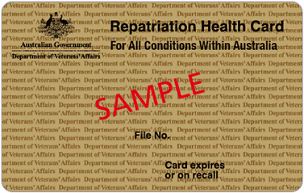

THE CARDS
GOLD card holders assessed on basis of clinical need
The TPI Gold Card looks the same but references Totally & Permanently Incapacitated
http://www.dva.gov.au/providers/dva-health-cards
Notes:
http://factsheets.dva.gov.au/factsheets/
Overview of cards Factsheet IS160
GOLD CARD
Factsheet HSV01

Slide 6
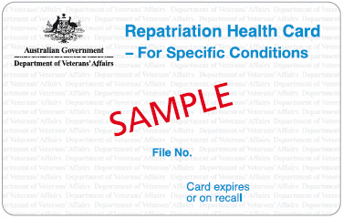
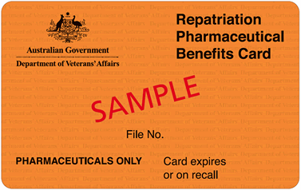
THE CARDS cont.
WHITE card holders assessed on basis of clinical need related to a specific Accepted Disability (AD)
No eligibility for RAP items
Pharmaceuticals ONLY
http://www.dva.gov.au/providers/dva-health-cards
Notes:
FACT SHEETS
http://factsheets.dva.gov.au/factsheets/
WHITE CARD
Factsheet HSV61
ORANGE CARD
Factsheet HSV69

Slide 7
AN OUTLINE OF
THE
MEDICAL GRADE FOOTWEAR
PROGRAM

Slide 8
MEDICAL GRADE FOOTWEAR (MGF)
Program Aim
  To provide MGF and related services that are of a high standard and clinically appropriate.
Purpose of MGF Supply
  Aims to restore, facilitate or maintain functional independence and/or minimise disability or dysfunction.
  MGF may be prescribed when readily available suitable everyday footwear cannot be used or modified for this purpose.

Slide 9
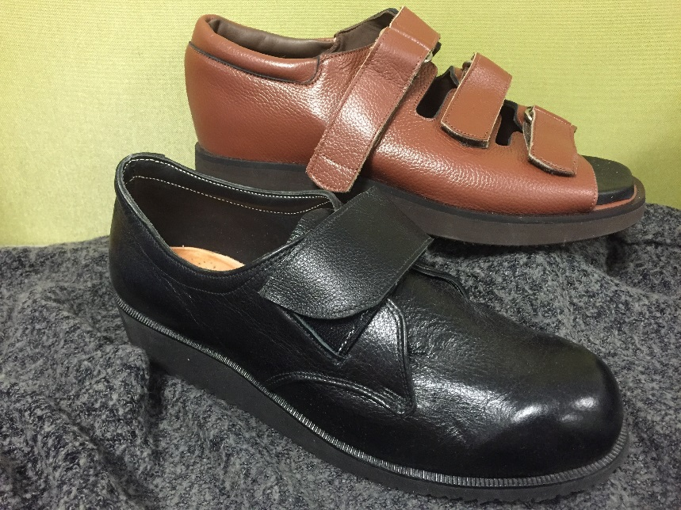
MEDICAL GRADE FOOTWEAR
Definition:
Footwear clinically prescribed to accommodate
and/or correct abnormal foot and/or ankle
structure or significant deformity.
DVA provides two types of medical grade footwear:
Ready made extra depth/width footwear
Custom made footwear

Slide 10
Medical Grade Footwear
READY MADE
Footwear that has specific features of extra depth and/or extra width added to the shoe last so the completed shoe can accommodate foot abnormalities.
This footwear is listed on the MGF Register:
http://www.dva.gov.au/providers/provider-programs/rehabilitation-appliances-program-rap#medical-grade
Acceptance on the MGF Register is determined by DVA in accordance with the departmental document
“Technical Specifications of Medical Grade Footwear”.

Slide 11
Medical Grade Footwear
CUSTOM MADE
Footwear manufactured to individual and DVA technical specifications.
Made from individual lasts/casts & patterns to replicate the feet.
Specifically designed to accommodate abnormal foot/ankle structure or gross deformities of the feet.
Provided where ready made MGF cannot accommodate these conditions and has been approved by DVA.

Slide 12
MEDICAL GRADE FOOTWEAR (MGF)
Assessors for MGF
  Podiatrists and certain medical specialists with the clinical expertise are the acceptable assessing health providers to complete MGF prescriptions – D0688 form. http://www.dva.gov.au/sites/default/files/dvaforms/D0688.pdf
Supply of MGF
  Suitably qualified and experienced MGF suppliers who have entered into an agreement with DVA, provide these services and products to DVA beneficiaries.

Slide 13
MEDICAL GRADE FOOTWEAR (MGF) - Assessors
Approved assessing health providers for MGF are
podiatrists or medical specialists i.e. Vascular Surgeon, Orthopaedic Surgeon, Rehabilitation Specialist or Rheumatologist.
Responsible to follow the outlined clinical pathway to determine appropriate management prior to prescribing MGF.
Refer to “Guidelines for Assessing Health Providers for the supply of Medical Grade Footwear”. http://www.dva.gov.au/providers/provider-programs/rehabilitation-appliances-program-rap#medical-grade

Slide 14
MEDICAL GRADE FOOTWEAR (MGF) - Supply
DVA contracts with suppliers of MGF. Suppliers may include orthotists, commercial shoe stores and MGF specialists.
Some provide only ready made extra depth/width shoes, some provide only custom made, some provide both types of MGF.
A supplier must agree with DVA’s Terms and Conditions. The “Notes for Medical Grade Footwear Suppliers” outlines the process and responsibilities of supply and DVA requirements.
http://www.dva.gov.au/providers/provider-programs/rehabilitation-appliances-program-rap#medical-grade

Slide 15
TECHNICAL CRITERIA
The document “Technical Specifications of Medical Grade Footwear” is available
as Attachment A in The Notes for Medical Grade Footwear Suppliers.
Overall, MGF should have:
Good quality leather uppers
Light coloured linings
Components free of wrinkles or creases
Designs that allow easy donning and doffing
Materials that enable an average lifespan expectancy of 2 years
Assessing health providers should case manage any issues with regards to quality, fitting and function of MGF directly with the supplier.

Slide 16
REFERRAL MGF FLOWCHART
Entitled persons can be referred by the LMO to either Medical Specialists or Podiatrists for MGF assessment.
Entitled person
LMO
Provides referral
Podiatrist
Assess and provides prescription for MGF
Specialist
Assess and provides prescription for MGF
Supplier
Measures, fits and supplies ready made MGF as appropriate or
Provides quote for supply of custom MGF
DVA – RAP section
Custom made MGF and modifications not listed on the MGF Schedule require prior approval

Slide 17
FORM D0688
FOR MGF PRESCRIPTION & SUPPLY
All MGF is supplied on the primary criteria that there exists sufficient clinical justification.
The Medical Grade Footwear Prescription form D0688 is to be used to prescribe MGF:
  Section A is completed by the assessing health provider according to their clinical assessment and review of the entitled person’s footwear.
  Section B is completed by the MGF supplier after measuring and conducting a trial fit where appropriate.
  Section C is completed by the assessing health provider after the MGF is supplied to verify quality, fit and suitability of the footwear.
D0688 form is available on the DVA website in pdf format for downloading:
http://www.dva.gov.au/sites/default/files/dvaforms/D0688.pdf

Slide 19
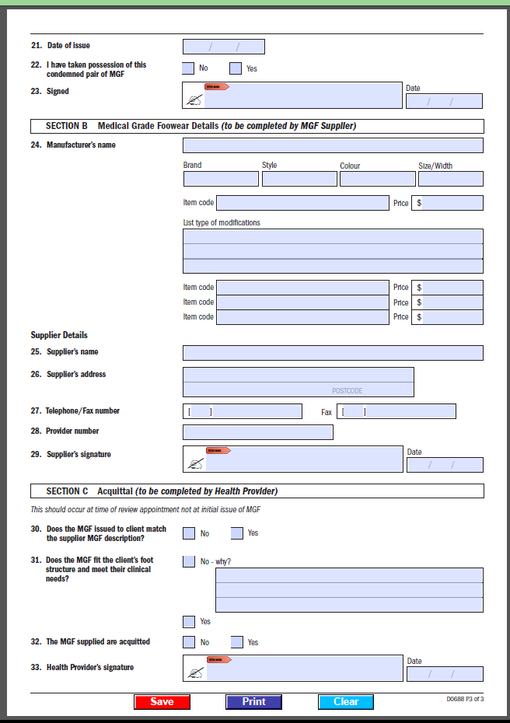

Slide 20
PRIOR APPROVAL PROCESS
Prior approval is required for MGF requests for custom, white card holders, recreational footwear and repairs and modifications not listed on the MGF Schedule of Fees.
The MGF supplier sends the completed D0688 into RAP for processing.
When DVA makes a determination notification will be sent to the:
  assessing health provider
  supplier
  entitled person.

Slide 21
READY MADE MGF PROCESS
Complete Section A of D0688: provide all clinical details and prescription requirements.
Give MGF prescription to the entitled person or send directly to DVA contracted MGF supplier.
Supplier will complete Section B: details of MGF to be supplied.

Slide 22
READY MADE MGF PROCESS
Supplier sends MGF to assessing health provider.
Assessing health provider issues MGF to entitled person.
  Ensures it is a DVA registered MGF
  Style, fit and quality are correct
Undertake the acquittal process.

Slide 23
CUSTOM OR RECREATIONAL MGF
PRIOR APPROVAL required
Complete all details on the D0688.
Refer to DVA contracted MGF supplier.
MGF supplier sends the completed D0688 into RAP for processing.
Notification will be sent to the
  assessing health provider
  supplier
  entitled person.

Slide 24
HOW MANY? - SHOES
2 pairs day/dress shoes at any one time. *
1 pair recreational shoes - where MGF needs to be modified to comply with a sporting club regulation. Must provide club letter confirming financial membership & playing status. REQUIRES PRIOR APPROVAL
1 pair work shoes if required by an employer, in addition to day shoes - may need confirmation from employer e.g. safety shoes. REQUIRES PRIOR APPROVAL
1 extra pair of day shoes for rural and remote residents (defined as >100km from a suitable assessing health providers).
* reference DVA document “Guidelines for Assessing Health
Providers for the Supply of Medical Grade Footwear” Section 5.1

Slide 25
CONDEMNING FOOTWEAR
“Condemn” footwear when no longer repairable or clinically suitable.
When condemning footwear and requesting replacement shoes, write details on script e.g. date approved, make, style, size, or colour.
Early condemning of footwear please write on prescription the reasons. Early condemning should only be due to a change in clinical circumstances not where an entitled person changes his/her mind.
Remove ALL condemned MGF from the possession of the entitled person at the appropriate time – most suitable when footwear is replaced with a new pair.
Notes:
IF YOU ARE UNSURE AS TO HOW MANY DVA SUPPLIED MGF THE entitled person HAS (OR SHOULD HAVE) CONTACT DVA FOR AN UPDATE FROM OUR SYSTEM RECORDS.
NB. SYSTEM RECORDS ARE CULLED OVER TIME TO INCREASE ELECTRONIC STORAGE CAPACITY

Slide 26
REPAIRS AND MODIFICATIONS
DVA pays for repairs to current DVA footwear - script given to the entitled person.
Routine repairs may be done by the original supplier without need for prescription.
Contracted suppliers are required to manage any warranty needs e.g. repairs (generally 12mths).
An exception: unless extreme access issues exist in visiting or sending shoes to the contracted supplier. If this is the case, assessing health provider needs to keep adequate notes.
After the warranty period repairs may also be done by non-contracted suppliers where access is difficult for the entitled person. The supplier will need to send the invoice to DVA with a copy of the script.
Repairs to stock footwear is limited to repair/replacement of modifications originally funded by DVA.

Slide 27
HOW MANY?
MODIFICATIONS TO NON DVA FOOTWEAR
Where an entitled person does not meet the criteria for MGF but clinically requires modifications to their own suitable self purchased stock footwear, the assessing health provider may refer them to a contracted supplier.
Clinically required modifications to non-DVA supplied footwear may include heel collars, sole raises, stretching etc.
Limit of 3 self purchased footwear can be modified in any one year.
Details of the modifications must be documented on the MGF prescription form.
Local repairers are able to modify footwear after the warranty period has passed - send invoice to DVA with a copy of the script.

Slide 28
FOOTWEAR EXCLUSIONS
The following shoe styles by their nature cannot meet MGF specifications and are precluded from being supplied:
stock or off-the-shelf shoes
slip-on shoes/boots/court shoes
runners/joggers – sports styled, dual density soling units
‘reef style’ or ‘orthopaedic’ sandals/shoes with moulded footbeds

Slide 29
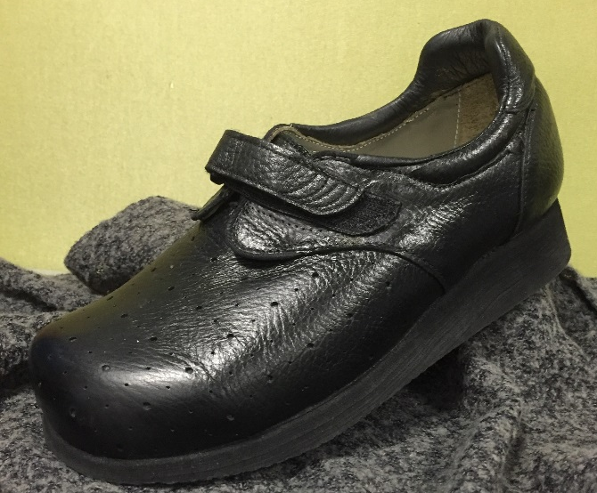
WARRANTIES
New ready made and custom MGF - 12 months (workmanship, materials, fitting).
Repairs/modifications - 3 months.
As a quality assurance measure – DVA may request the return of shoes that have failed to last an acceptable period of time.

Slide 30
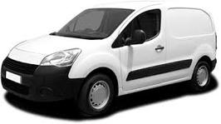
HOME VISITS BY SUPPLIERS
Home visits must be requested on the prescription form by the assessing health provider outlining the clinical reasons why the entitled person cannot be transported to the supplier.
Considered only where it is clear that the entitled person is medically confined to home. A general rule of thumb is –
1 (one) home visit for ready made MGF; and
2 (two) visits for custom MGF when requested by the assessing health provider.
Home visits can be claimed directly by the supplier, in accordance to the “DVA Schedule of Fees Medical Grade Footwear Suppliers”.

Slide 31
PODIATRY ADVISERS
Podiatrist advisers are available for you to discuss any MGF issues and/or treatment concerns.
DVA Health Provider Line
  1300 550 457 (metro)
  1800 550 457 (regional)
  Press Option 1 for RAP (aids and appliances & medical grade footwear)

Slide 32
WEBSITE LINKS
Medical Grade Footwear
  RAP Schedule of Equipment, prescription form
  MGF Register, list of Suppliers & Prescriber guidelines
http://www.dva.gov.au/providers/provider-programs/rehabilitation-appliances-program-rap#medical-grade
MGF & Podiatry Fee Schedules
http://www.dva.gov.au/providers/fee-schedules/dental-and-allied-health-fee-schedules

Slide 33
GUIDELINES FOR THE CLINICAL ASSESSMENT
FOR
MEDICAL GRADE FOOTWEAR

Slide 34
Procedures for assessing lower limb management
Podiatrists must assess the entitled person by the following order of interventions, as clinically appropriate:
  1. Is there more appropriate stock footwear;
  2. Corrective insoles/orthoses;
  3. Modifications to stock footwear;
  4. Ready made footwear; or
When no other clinically suitable option remains, the prescription of:
  5. custom footwear.

Slide 35

Key to Success 1
Thorough assessment of the entitled person’s foot type and shape is the first step to prescribing adequate treatment interventions, orthoses or footwear.

Slide 36


ASSESSMENT GUIDELINES
Step 1 Full examination of foot
    foot morphology
    bony abnormalities/exostoses
    digital deformities
    oedema
    the ‘at risk’ foot
Step 2 Gait
    structural weakness
    abnormal function
    condition of footwear in use

Slide 37

ASSESSMENT GUIDELINES Cont.
Step 3 Adjunct therapies
- padding and strapping
    digital devices e.g. ID spacers, props
    - internal shoe e.g. accommodative or
    functional devices, AFO’s
- external shoe e.g. upper and outsole modifications, callipers/T-straps
- systemic e.g. medication review, compression hosiery, lymphatic drainage

Slide 38

Key to Success 2
Determine what is the goal when prescribing footwear:
To accommodate abnormal foot structures
To facilitate stability
To facilitate gait correction or support
MGF will not be provided for the sole
purpose of accommodating orthoses.

Slide 39
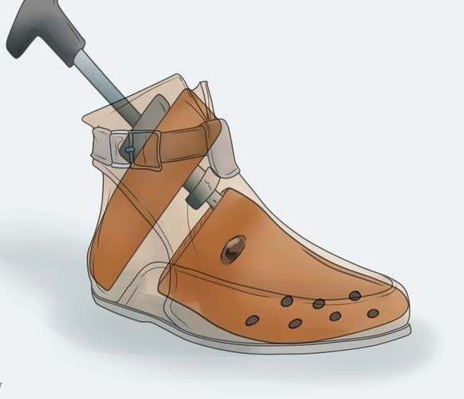
Key to Success 3
Is the existing footwear suitable for the clinical condition?
Existing footwear can be improved with
shoe modifications without need for MGF
Where necessary, entitled persons should be advised to purchase more appropriate footwear
Readily available off-the-shelf footwear is an acceptable choice if it has adequate depth, width, and stability. Modifications can assist further suitability.

Slide 40
MGF can be prescribed when:
appropriate treatment and appliance therapy
have been tried and failed.
where appropriate, shoe modifications to the
entitled person’s own footwear have been tried
and failed.
there is significant clinical need and the
deformity or condition cannot be managed
without the use of ready made or custom MGF.

Slide 41
Key to Success 4
What footwear and/or appliances are available to accommodate this clinical condition?
Stay abreast of the footwear styles available both off-the-shelf and from the DVA MGF Register.
The D0688 prescription form should indicate the type of footwear to be considered including any additional orthotic devices or appliances.
Complex or difficult cases should be discussed with the MGF supplier and/or DVA podiatry advisers to ensure the clinical needs of the entitled person can be met.

Slide 42
SUMMARY
Key to success 1:
Thorough assessment of the entitled person’s foot type and shape is the first step to prescribing adequate footwear.
Key to success 2:
What do I want to achieve with the footwear?
Key to success 3:
Is the existing footwear suitable for the clinical condition?
Key to success 4:
What footwear and/or appliances are available to accommodate this clinical condition?

Slide 43
BASIC FOOTWEAR COMPONENTS
Back Quarter - quarters are the back sections of the upper which support and help control the hind-foot.
Heel Counters – should be firm; often extended medially and/or laterally in MGF.
Insoles - cut from last shape and determines the shape of the shoe, the waist support and flexibility.
Linings - material used to contact the foot for the purpose of absorbing perspiration, reducing heel slip, durability.
Lug Length - the top opening of the shoe which runs down the dorsum of the midfoot (the lace area). The length is usually a standard proportion of the shoe. May be extended down the toebox. e.g. commonly extended for high insteps or forefoot amputations.

Slide 44
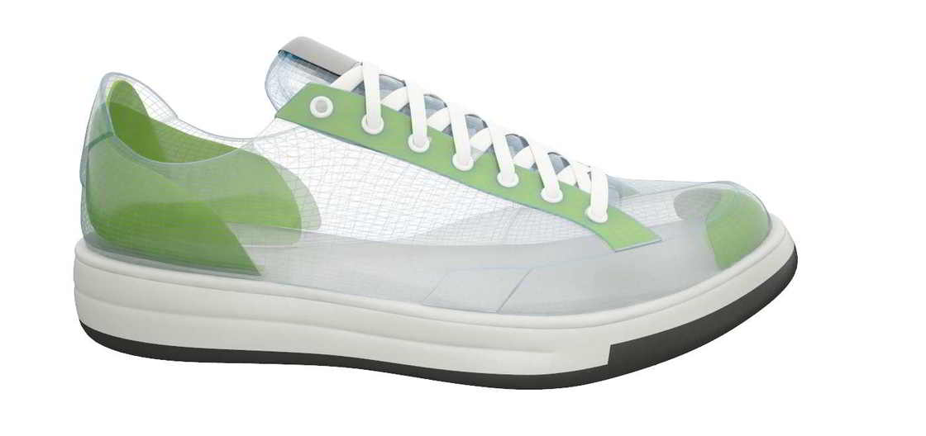
BASIC FOOTWEAR COMPONENTS cont.
Outsole - base of shoe which contacts the ground – durable.
Shank - reinforces the mid section of the shoe – critical!
Toe Puffs - can be walled or extend onto the dorsum over the digits.
Tongue - may be padded or stitched down.
Vamp - The material section of the shoe which covers the top part of the foot.

Slide 45
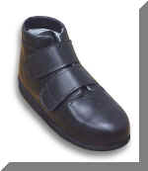
Deciding Ready Made or Custom
There are many factors which affect this decision.
Foremost consideration should be given to any fluctuating clinical conditions. They will need to be stable before prescribing MGF e.g. oedema, recent foot surgery.
It is essential that there is an up-to-date medical history.
The following shoe features should
also be considered:
Counter
Lug Length
Modifications

Slide 46
CUSTOM
Custom is generally required when:
Toe box needs to be 30mm or higher
Forefoot width is in excess of 3 fittings wider than
hindfoot
Equinus foot shape
Rocker bottom foot
Severely adducted or abducted forefoot
Excessive oedema
Severe Rheumatoid deformities
Other deformities which cannot be accommodated in
depth/width footwear e.g. marked asymmetry between feet

Slide 47
FOOTWEAR PRESCRIPTION D0688
Clinical justification is paramount in
establishing eligibility for MGF.
The D0688 should record the following:
Subjective symptoms.
Objective assessment - should describe the degree of abnormal foot/ankle structure or deformity and how it cannot be accommodated within stock footwear.
Other therapies considered/trialed to best accommodate the foot.
Current footwear/modifications tried.
Identify styles/brands of appropriate stock shoes trialed.

Slide 48
FILLING IN THE
PRESCRIPTION FORM D0688
  Assessing health providers should consult the “clinical
  pathway for footwear assessment” to determine
  appropriate management prior to prescribing MGF.
The main points to include on the prescription:
Clinical information and footwear details to justify MGF
Information regarding modifications/repairs
List clearly any special instructions
NOTE: refer to the DVA document “Guidelines for Assessing Health
Providers for the supply of Medical Grade Footwear” Section 4.4 & 4.5.
When insufficient details are provided the process of supply may be delayed.
Notes:
ONLY AVAILABLE NOW ON-LINE!
REQUEST FOOTWEAR IS SENT TO YOUR CLINIC FOR DISPENSING - your responsibility is to make timely appointments for dispensing and returning voucher for supplier payment
DELAYS IN DVA PROCESSING MAY OCCUR WHEN:
Sections on the D0688 prescription form are left BLANK;
Clinical information regarding abnormal pathologies etc are brief or non-descript;
Previous DVA issued MGF is not identified for replacement/condemning

Slide 49
ACQUITTALS
The podiatrist prescribing the MGF is the
case manager and has the responsibility to hold accountable the supply of MGF.
Acquittal process
Acquittal is the formal “sign off” that the footwear is as prescribed by the case manager and suitable for the purpose for which it has been requested.
Acquittal maintains the warranty.
Acquittals are to be recorded by the assessing health provider on the D0688 or in the entitled person’s clinical notes and comments made as necessary.
Notes:
PROVIDERS ARE ENCOURAGED TO CLAIM FOR ACQUITTALS WHEN A SEPARATE APPOINTMENT IS MADE FOR THIS CONSULTATION
USE ITEM CODE F019

Slide 50
PROCESS OF ACQUITTAL
Keep a record of acquittal dates and information.
Acquittals should be done within 1-2 months of footwear being supplied.
Problems at acquittal are the responsibility of the assessing health provider to liaise with the supplier to adequately resolve the issue(s) in a timely manner.
The assessing health provider must review all footwear issued in accordance with the original prescription.
Modifications to footwear must be reviewed.
Excessive wear and quality issues should be referred to DVA rather than condemn and replace.

Slide 51
PRESCRIPTION OF STOCK FOOTWEAR
Requested through Rehabilitation Appliances Program (RAP)
Prescribed on DVA Form D0992. Available on DVA website at
http://www.dva.gov.au/providers/provider-programs/rehabilitation-appliances-program-rap#schedule-equipment-docs
Stock - AJ07 Footwear for Limb prosthesis
- Issued as essential part of a leg appliance e.g. amputee
Temporary footwear (AJ06)
- cast boots/shoes e.g. “DARCO”, Pullman slippers
Notes:
SEARCHING ON THE NEW WEBSITE AS OF 2015:
PROVIDERS (navy blue header)
=> PROVIDER PROGRAMS
=> RAP
o National Schedule of Equipment
search ‘Pod’
o Contracted Suppliers of Equipment
“MFS” Group
o Forms D0992

Slide 52
TRANSPORT TO PODIATRY TREATMENT
entitled persons can claim reimbursement for travel costs for medical treatment to the closest practical provider - taxis or mileage (incl. to contracted footwear supplier or orthotist appointment).
Booked Car Scheme (BCS) is available to all entitled persons aged 80 years of age or over
  Health providers can arrange transport under the Booked Car Scheme on behalf of the entitled person by phone, fax, email or through the online transport booking system.
Details online at:
http://www.dva.gov.au/providers/provider-programs/travel-treatment

Slide 53
MGF
COMPLICATIONS & DIFFICULTIES
What if:
the footwear provided by the contracted supplier is not suitable:
The assessing health provider should:
  NOT acquit the footwear;
  advise supplier ASAP; and
  discuss and organise appropriate action.
the entitled person changes his/her mind:
  The entitled person has financial responsibility for costs.
the nearest contracted supplier is too far away:
  Liaise with supplier to work out possible solution e.g. foot tracings, girth measurements.
  Let DVA know of any unresolved issues.
the nearest supplier cannot supply the most suitable MGF:
  Other contracted suppliers can be contacted.
  * Maintain adequate records to support all decisions.

Slide 54
MGF
COMPLICATIONS & DIFFICULTIES
    What if:
  you are unsure as to the most appropriate shoe:
    Be specific in description of MGF characteristics.
    Liaise with your MGF supplier.
    Discuss with a DVA podiatry adviser.
  you assess the client as not meeting clinical criteria:
    Explain to the client and do not complete D0688; or
    Send completed D0688 directly to DVA and attach a note indicating assessment that stock footwear is suitable.
    Keep precise clinical notes for review by DVA if requested.

Slide 55
MGF SUPPLIER LOCATIONS
Contracted MGF suppliers are located throughout each State
Please see the link below to locate the closest contracted supplier
http://www.dva.gov.au/providers/provider-programs/rehabilitation-appliances-program-rap#medical-grade

Slide 56
MEDICAL GRADE FOOTWEAR
Thank you
This completes the online training.
Should you have further questions about MGF
or the content of this presentation please contact
DVA Health Provider Line

Slide 57
MEDICAL GRADE FOOTWEAR CONTACT NUMBERS
DVA Health Provider Line
  1300 550 457 (metro)
  1800 550 457 (regional)
  Press
  Option 1 for RAP (aids and appliances & medical grade footwear)
  Option 3 for Medical & Allied Health (podiatry treatment)

